Slide 1

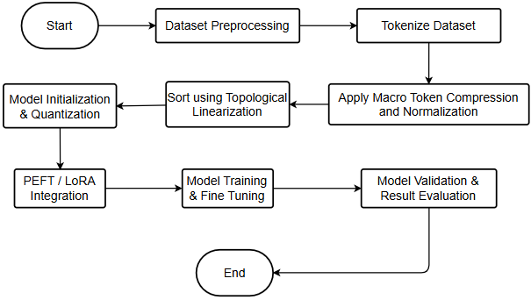
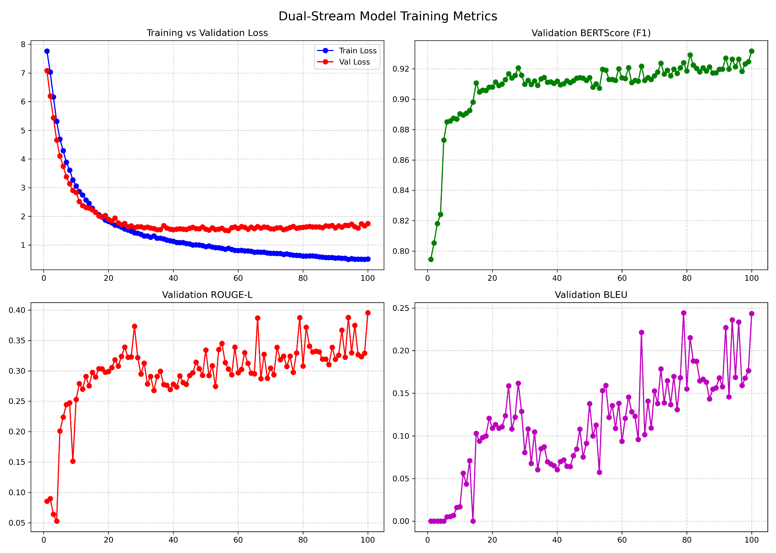
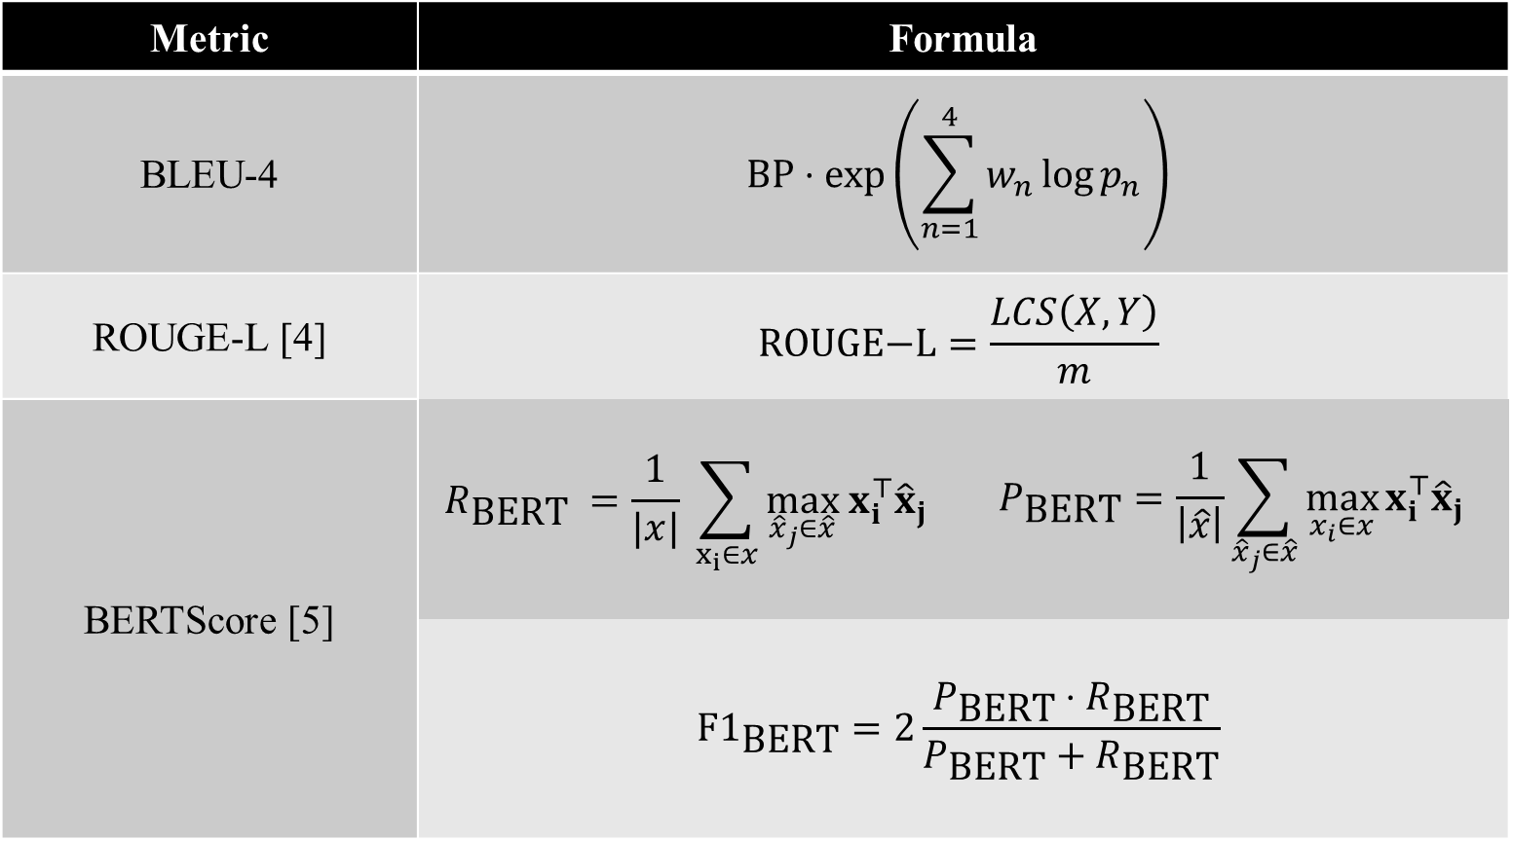

STEP File Tokenizer for Transformer-based Annotation
Panji Darma, Hans Sebastian Faculty of Engineering and Technology
Abstract
Methods
Findings/Results
This study proposes a novel Transformer-based architecture for the direct classification and annotation of raw Boundary Representation (B-Rep) STEP files. A pre-trained GPT2 transformer model is equipped with additional specialized tokens according to ISO 10303 STEP file format to natively parse the complex topological graph structure of Boundary Representation (B-Rep) models into a discrete sequence of tokens. Parameter-efficient Fine Tuning (PEFT) via Low-Rank Adaptation (LoRA) are implemented to enable it to map continuous geometric vectors into English semantic descriptions without removing learned grammar and syntax rules. A modified version of the ABC dataset which are embedded with AI-based annotations generated using Gemini 3.1 Pro and verified by human reviewers is used to train the model. Preprocessing steps includes file filtering based on size in megabytes (MB) to ensure proper training. A Hierarchical Dual-Stream Tokenizer is employed to resolve graph isomorphism through Semantic Macro-Compression, Canonical Normalization, and Topological Linearization. A Dual-Stream Encoding strategy fuses discrete semantic tokens with complex-valued geometric embeddings via Geometry-Infused Attention and Rotary Positional Embeddings (ROPE) [2]. Model performance is evaluated using BERTScore, BLEU-4, ROUGE-L, and cross-entropy loss, with a focus on maximizing semantic similarity to avoid undetected functional categories. The results highlight the comparative strengths and limitations of the model, providing insights into its suitability for scalable and reconstruction-free CAD indexing.
This paper utilizes a Geometric-Semantic Adapter system with a Transformer base for annotating CAD geometry using a dual-stream Tokenizer architecture. The procedure includes the following steps:
Data Preparation:
A hybrid dataset was constructed using specific samples of the ABC dataset consisting of labeled geometric topologies and semantic descriptions based on Text2CAD annotation [2]. The dataset contains 100 high-fidelity STEP CAD files validated by humans for manifold integrity and proper annotation.
Feature Extraction & Preprocessing:
Using a Hierarchical Dual-Stream Tokenizer, topological features were extracted from the B-Rep graphs. The data was simplified via Semantic Macro-Compression, aligned to a canonical Z-axis using Principal Component Analysis (PCA), and serialized using Topological Linearization (Canonical DFS). Additionally, the geometric data is extracted and combined using Rotationary Positional Embeddings (RoPE) to ensure the attention mechanism correctly measures angular offsets, embedding physical assembly logic directly into the network. [3].
Model Development:
A Geometric-Semantic Adapter model was trained using a Generative Pre-trained Transformer (GPT) backbone. Parameter-Efficient Fine Tuning (PEFT) via Low-Rank Adaptation (LoRA) was utilized to adapt the attention and feed-forward layers of the backbone while freezing the other components of the base model.
Evaluation Metrics:
The performance of the Geometric-Semantic Adapter model is measured using the following metrics:
Aggregated Metrics (Averaged per 20 Epochs)
Training Metrics Graph
No | T. Loss | V. Loss | BERTScore F1 | ROUGE-L | BLEU-4
1 | 3,59 | 3,26 | 0,88 | 0,23 | 0,04
2 | 1,39 | 1,65 | 0,91 | 0,30 | 0,10
3 | 0,95 | 1,56 | 0,91 | 0,30 | 0,10
4 | 0,71 | 1,60 | 0,92 | 0,32 | 0,15
5 | 0,55 | 1,66 | 0,92 | 0,34 | 0,18
Introduction
Analysis
The use of computers in engineering designs have largely replaced manual, hand-drawn design methods such as blueprints and whiteprints which are time-consuming and doesn’t allow for quick iterations. However, managing large amounts of computer-aided designs (CAD) assets is currently hindered by a reliance on time-consuming manual annotation, which is prone to human error.
Attempts of using automated classification methods such as utilizing artificial intelligence (AI) face limitations which include the need of a lossy conversion to other formats such as 2D/3D representations or graphs [1], which increases inference time and model complexity. Other issues such as incompatible proprietary file formats and overreliance on file metadata negatively impacts the accuracy of these methods.
Addressing these issues involves combining existing AI-based methods such as Transformer-based large language models for semantic annotation and natural language generation with a fixed, deterministic tokenization method for parsing and processing CAD files which only considers the underlying topological data integrated with the necessary geometric (numeric) data, eliminating the reliance of metadata which might pollute the model with irrelevant/misleading information.
The evaluation of the Geometric-Semantic Adapter model revealed a strong capability for functional semantic comprehension, achieving a peak validation BERTScore F1 of 0.93 that remained stable through the final epoch. The Cross-Entropy loss demonstrated robust learning dynamics; the training loss minimized at 0.50, while the validation loss reached a minimum of 1.50 before forming a mild plateau at 1.74. This confirms that the quantized Parameter-Efficient Fine-Tuning (PEFT) strategy successfully mitigated overfitting while allowing the model to extract generalized geometric rules.
Conversely, generative syntactic metrics recorded lower absolute performance, with ROUGE-L reaching a maximum value of 0.40 and BLEU-4 peaking at 0.24. This disparity highlights the inherent volatility of strict, exact $n$-gram matching when translating continuous parametric constraints. While the model accurately categorizes the high-level functional identity of an object, predicting exact phrasing and dimensions of the object results in $n$-gram fragmentation and structural hallucination errors.
Metric | Formula
BLEU-4 | $$\text{BP}⋅\exp\left(\sum_{n=1}^{4}{w_{n}}\log{p_{n}}\right)$$
ROUGE-L [4] | $$\text{ROUGE}\text{−}\text{L}=\frac{LCS\left(X,Y\right)}{m}$$
BERTScore [5] | $$R_{\text{BERT}} =\frac{1}{|x|} \sum_{x_{i}∈x}{\max_{{\hat{x}}_{j}∈\hat{x}} x_{i}^{⊤}{\hat{x}}_{j}}$$ | $$P_{\text{BERT}}=\frac{1}{\left|\hat{x}\right|}\sum_{{\hat{x}}_{j}∈\hat{x}}{\max_{x_{i}∈x}{x_{i}^{⊤}{\hat{x}}_{j}}}$$
 | $${\text{F}\text{1}}_{\text{BERT}}=2\frac{P_{\text{BERT}}⋅R_{\text{BERT}}}{P_{\text{BERT}}+R_{\text{BERT}}}$$
Conclusions/Summary
References
This research demonstrates that the strategic integration of a novel Hierarchical Dual-Stream Tokenizer with a quantized Generative Pre-trained Transformer (GPT) creates a robust framework for an automated, reconstruction-free annotation of Computer-Aided Design (CAD) files. The proposed architecture is capable of natively processing the raw topology and geometric primitives contained in B-Rep data without the need to utilize external metadata or converting them into lossy visual formats. Furthermore, the application of PEFT through LoRA provided the necessary requirement of handling semantic and geometric tokens generated from the tokenizer.
The proposed model was able to translate B-Rep data into semantic-geometric tokens while entirely preserving the foundational grammatical syntax and reasoning capabilities of the frozen GPT2 backbone. The findings provide compelling evidence that smaller language models, when equipped with specialized topological tokenization, possess the intrinsic capability to directly interpret, analyze, and accurately categorize complex mechanical geometry for real-world industrial and manufacturing workflows.
Future iterations of this research will focus on scaling the core architecture by transitioning to larger pre-trained foundational models. Utilizing models with higher parameter counts will expand the network's latent capacity, theoretically improving its zero-shot geometric reasoning and reducing the syntactic volatility observed in exact-match metrics. Additionally, increasing the maximum token output size will be a priority. Expanding the generation window will allow the system to output comprehensive, multi-level parametric specifications for massive, multi-part industrial assemblies without suffering from sequence truncation or degradation.
L. Mandelli and S. Berretti, Cad 3d model classification by graph neural networks: A new approach based on step format, arXiv.org, Oct. 2022. Accessed: Oct. 13, 2025. [Online]. Available: https://arxiv.org/abs/2210.16815.
M. S. Khan, S. Sinha, T. U. Sheikh, D. Stricker, S. A. Ali, and M. Z. Afzal, “Text2cad: Generating sequential cad models from beginner-to-expert level text prompts,” arXiv.org, Sep. 2024. DOI: https://doi.org/10.48550/arXiv.2409.17106. Accessed: Dec. 8, 2025. [Online]. Available: https://arxiv.org/abs/2409.17106v1
J. Su, Y. Lu, S. Pan, B. Wen, and Y. Liu, “Roformer: Enhanced transformer with rotary position embedding,” CoRR, vol. abs/2104.09864, Nov. 2023. DOI: https://doi.org/10.48550/arXiv.2104.09864. [Online]. Available: https://arxiv.org/abs/2104.09864.
C.-Y. Lin, Rouge: A package for automatic evaluation of summaries, Jul. 2004. Accessed: Dec. 8, 2025. [Online]. Available: https://aclanthology.org/W04-1013.pdf.
T. Zhang, V. Kishore, F. Wu, K. Q. Weinberger, and Y. Artzi, “Bertscore: Evaluating text generation with bert,” CoRR, vol. abs/1904.09675, Feb. 2020. DOI: https://doi.org/10.48550/arXiv.1904.09675. Accessed: Dec. 9, 2025. [Online]. Available: http://arxiv.org/abs/1904.09675.

